Slide 1


Protection - on the road to recovery?
Ron Wheatcroft, Swiss Re, Protect Association 10 July 2015

Slide 2
Boxing Day 1963
League leaders Blackburn won 8-2 against West Ham away from home, as they enjoyed another trip to London. Earlier in the season, Rovers had hit seven against Tottenham and four against Arsenal and inflicted the heaviest ever home defeat on a West Ham side who had not won in the First Division since November 2.
Fulham 10-1 Ipswich was a result that remains both Fulham's record league win and Ipswich's heaviest defeat and was all the more impressive as the Tractor Boys had been champions only 18 months earlier. Ipswich's deep-lying forward Jimmy Leadbetter had received plenty of praise in
Source: The Daily Mirror , 27 December 1963

Slide 3
Boxing Day 1963
"Their [West Ham's] tactics were all wrong and their covering terrible. Blackburn on a rain-lashed, pudding of a pitch, banged the ball about with poise and precision." It was attrition warfare, as Fred Pickering opened the scoring after seven minutes and Bryan Douglas made it two after half an hour.
Before the break, it was 4-0 with goals from Andy McEvoy and Mike Ferguson. In the second-half, Pickering and McEvoy strolled through the Hammers' ''woefully weak defence'' to claim their hat-tricks and, despite Johnny Byrne's double, there was no way back."

Slide 4
Boxing Day 1963
''It must have been those lovely turkeys we gave 'em for Christmas. From now on, they get one every week.
Fulham manager Bedford Jezzard
"It could have gone either way until the match began."
Ipswich chairman John Cobbold

Slide 5
Percentage change in new retail policy sales 2012 and 2013
Product type
All term policies, including those with CI riders | -17.4%
Whole life cover | -21.8%
Whole life guaranteed acceptance | -7.3%
All CI policies, accelerating life cover and stand alone | -20.2%
Income protection | -24.4%

Slide 6
Twelve months on 2013/2014. On the road to recovery?
Volume
Premium
Term assurance + 5.2%
    With critical illness + 5.6%
    Without critical illness + 5.0%
Critical illness + 4.4%
    Accelerated CI + 5.6%
    Stand-alone CI - 17.3%
Income protection + 6.7%
Whole life + 0.2%
    Guaranteed acceptance - 1.3%
    Non-linked + 13.8%
    Unit-linked + 10.0%
Term assurance + 6.6%
    With critical illness + 9.4%
    Without critical illness + 5.3%
Critical illness + 8.1%
    Accelerated CI +9.3%
    Stand-alone CI - 21.1%
Income protection +8.2%
Whole life +5.0%
    Guaranteed acceptance + 7.2%
    Non-linked + 1.8%
    Unit-linked - 10.8%
Notes:
Volumes
Term
from 1.279mio to 1.216mio ➔ +5.2% increase
- With CI, from 423k to 446k ➔ +5.6% increase
- W/O CI, from 793k to 832k ➔ +5.0% increase
CI
from 445k to 465k ➔ +4.4% increase
-Accelerated: from 423k to 447k ➔ +5.6% increase
-Stand alone: from 22k to 18k ➔ -17.3% decrease
IP
From 90mio to 96mio ➔ 6.7% increase
WL
From 85 to 89 mio ➔ 5.0% increase
- Guaranteed acceptance, from 246k to 243k ➔ -1.3% decrease
- Non-linked excl. funeral plans / over 50, from 26'441 to 30'092 ➔ 13.8% increase
- Acc. CI whole life (unit linked), from 653 to 718 ➔ +10.0%
Premiums
Term
from 473mio to 506mio ➔ +7.6% increase
- with CI, from 212mio to 231mio ➔ +9.4%
- without CI, from 260mio to 274mio ➔ +5.3%
CI
Overall, from 223mio to 241mio ➔ +8.1% increase
Stand alone: from 10mio to 8mio ➔ Change = -21.%
CI – Stand Alone = ACCI, from 212mio to 232mio ➔ Change = +9.3%
IP
From 38.5mio to 41.7mio ➔ +8.2% increase
WL
From 85 to 89 mio ➔ +5.0% increase
- Guaranteed acceptance, from 52mio to 56mio ➔ 7.2% increase
- Non-linked excl. funeral plans / over 50, from 31.9mio to 32.5mio ➔ 1.8% increase
- Acc. CI whole life (unit linked), from 762mio to 680mio ➔ -10.8% decrease

Slide 7
Distribution split 2013/14
*Directly-authorised refers to any business of that nature, including IFAs. It isn't pure IFA business.
Notes:
2013 – individual term – some misreporting identified by one provider after we published. Percentage figures close to reported CI

Slide 8
Total new individual term sales split between stand-alone term and term with ACCI, 2010-14 by volume

Slide 9
Total new individual critical illness policy sales, including stand-alone and accelerated life cover, 2010-14
Stand-alone sales 18,208
  Decreased 17.3% since 2013 and 45.6% since 2012
96% sales are accelerated life cover
Notes:
Market down 17.3% by volume (22,006 in 2013, 18,208 policies sold in 2014)
Metlife sold no policies in 2014 (cf 4,323 in 2013)
3 further firms saw changes in y-o-y sales of more than 3% of the 2014 market
Friends +5%; HSBC +6%; Zurich -5%
3 firms saw decreases of 1-2% of the 2014 market
LV, LBG, Royal London

Slide 10
Top five providers, new individual term sales (including term with CI), 2013–14, by policy sales
2014 |  |  |  |  | 2013 |  |  |  | 2014/13
Rank | Company Name | Total | % of Total |  | Rank | Total | % of Total |  | % Change
1 | Legal & General | 455,204 | 36% |  | 1 | 363,970 | 30% |  | 25%
2 | Aviva | 222,061 | 17% |  | 2 | 210,132 | 17% |  | 6%
3 | Friends Life | 115,849 | 9% |  | 4 | 99,415 | 8% |  | 17%
4 | Lloyds Banking Group | 112,918 | 9% |  | 3 | 174,631 | 14% |  | -35%
5 | AIG Life | 82,463 | 6% |  | 5 | 72,597 | 6% |  | 14%

Slide 11
Top five providers, new individual CI sales, including stand-alone and accelerated life cover, 2013-14
2014 |  |  |  |  | 2013 |  |  |  | 2014/13
Rank | Company Name | Total | % of Total |  | Rank | Total | % of Total |  | % Change
1 | Legal & General | 130,291 | 28% |  | 1 | 106,094 | 24% |  | 23%
2 | Aviva | 71,960 | 15% |  | 3 | 55,376 | 12% |  | 30%
3 | Friends Life | 64,398 | 14% |  | 4 | 49,678 | 12% |  | 30%
4 | Lloyds Banking Group | 62,800 | 13% |  | 2 | 99,236 | 22% |  | -37%
5 | Vitality | 43,773 | 9% |  | 5 | 30,538 | 7% |  | 43%

Slide 12
Total new individual IP sales by volume, 2010-14

Slide 13
Top five product providers, new individual income protection sales, 2013-14
2014 |  |  |  |  | 2013 |  |  |  | 2014/13
Rank | Company Name | Total | % of Total |  | Rank | Total | % of Total |  | % Change
1 | Friends Life | 20,255 | 22% |  | 1 | 17,798 | 20% |  | 14%
2 | LV= | 19,679 | 21% |  | 3 | 12,723 | 14% |  | 55%
3 | Legal & General | 10,890 | 12% |  | 4 | 8,043 | 9% |  | 35%
4 | Lloyds Banking Group | 7,494 | 8% |  | 2 | 12,758 | 14% |  | -41%
5 | Exeter Family Friendly | 6,498 | 7% |  | - | - | - |  | -

Slide 14
Total new individual whole life policy sales, unit-linked, non-linked and guaranteed acceptance plans, 2010-14

Slide 15
The overall market mood
Mostly positive
Positive about 7 Families – similar messages through Group Watch
Increasing signs of provider willingness to improve D2C on-line offerings
…but not everybody!
Lack of truly innovative value add to stimulate potential customers
Reduced distribution reach post MMR and RDR; Plus shortage of Protection Experts
A number of new entrants and initiatives
Protection marketplace has again failed to grow at the rate it should for a number of key reasons.
Rate focused online sales models
Efforts to heighten to the profile of the industry, which should in time see long term growth
Notes:
POSITIVE
There have been a number of positive moves within the protection market in 2014, with a number of new entrants and initiatives. This all works towards heightening the profile of the industry and its products, which should, in time, see long term growth.
Increasing signs of provider willingness to improve D2C on-line offerings.
Positive about 7 Families – similar messages through Group Watch
LESS POSITIVE / NEGATIVE
The Protection marketplace has again failed to grow at the rate it should for a number of key reasons.
Reduced distribution (Active Adviser numbers) reach as a result of post RDR & MMR impacts on advisory and mortgage distribution models.
Lack of innovative true added value being provided to stimulate potential customers 3.
Rate focused online sales models driving customers to believe protection is a mere commodity with price the only important feature!
A Lack of professional knowledgeable advisers who are expert in providing Protection

Slide 16
The mortgage market
Introduction of MMR
"Protection volumes were impacted by the introduction of MMR from March last year, although the impacts seem to affect some distributors more than others with some reporting significant reductions.“
"The launch of the Mortgage Market Review could have been a great opportunity for protection, but actually turned in to a dampener to protection sales as this is not part of the MMR process.“
"We don't do very well at covering mortgages. Somehow, the unintended consequence of the MMR has been to place the focus on affordability but with less on what might impact that. Protection appears to be seen as a cost to be set aside if needed to fit into an affordability model."
Other
"We haven't really addressed properly the need to protect rental costs (probably a subset of income protection and we are bad, make that awful, at that too. "
As an industry dependent to a large extent on mortgage-related business, how ready are we for changes in home buying and renting? People buying later changes the need.

Slide 17
The distribution challenges
"A lot points to growth in digital but how do we make the proposition compelling when we keep on repeating what we have done historically?" (Do we?)
"There's a desperate need for better industry promotion; mostly, we do a very good job. It's just that we aren't very good at articulating it in a way people find interesting."
"Encouraging wealth management advisers to write more protection business has remained hard work." (is this true?)
"Aggregators taking greater share of direct life sales adding to its commoditisation. Only Vitality really trying something different.“
"We are still 'junkies' on a fix of IFA distribution and we know we need go through 'cold turkey' but we can't bring ourselves to suffer the short term pain. That said the 'methadone' of direct channel and moreover digital distribution doesn't seem that great as an alternative!"
A growing advice gap (not just a protection issue)
What will replace bancassurance? There's a general lack of distribution power for what is a voluntary product purchase.

Slide 18

UK post-Election position
Heavily indebted government seeking to 'balance the books'
Largest protection gap in Europe
Increasing withdrawal of state safety nets
Mitigating activity, so far, largely confined to the margins

Slide 19

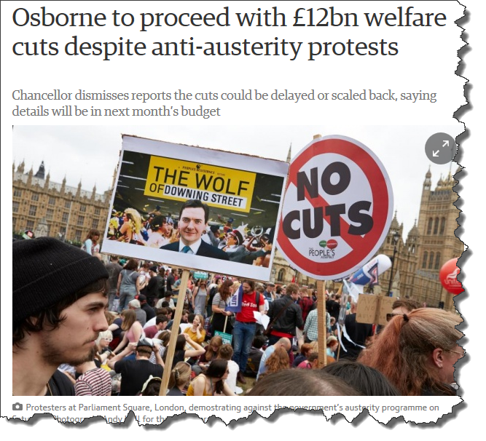
UK activity

Slide 20
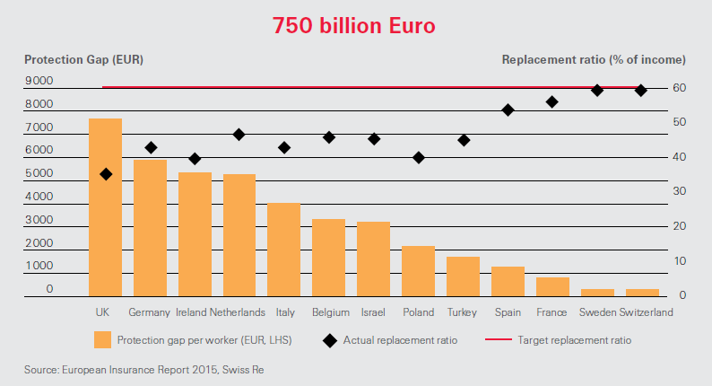
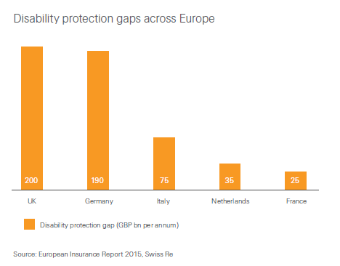
The extent of the IP shortfall across EU markets
Disability Gap using 60% income replacement ratio

Slide 21
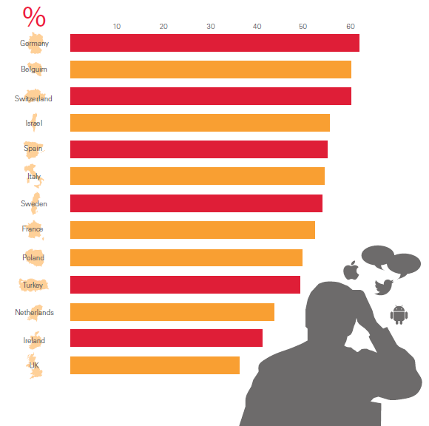
Distribution channel as a barrier
Digital aversion in general, as a % of consumers, is different for different countries
Swiss Re European Insurance Report, 2015

Slide 22
How comfortable would you be taking out life or protection insurance through the following ways?
Source: Swiss Re European Insurance Report 2015

Slide 23
On the road to recovery?
In 1964, West Ham won the FA Cup, beating Preston North End 3-2
Ipswich went on to win the UEFA Cup in 1981

Slide 26
Legal notice
©2015 Swiss Re. All rights reserved. You are not permitted to create any modifications
or derivative works of this presentation or to use it for commercial or other public purposes
without the prior written permission of Swiss Re.
The information and opinions contained in the presentation are provided as at the date of
the presentation and are subject to change without notice. Although the information used
was taken from reliable sources, Swiss Re does not accept any responsibility for the accuracy
or comprehensiveness of the details given. All liability for the accuracy and completeness
thereof or for any damage or loss resulting from the use of the information contained in this
presentation is expressly excluded. Under no circumstances shall Swiss Re or its Group
companies be liable for any financial or consequential loss relating to this presentation.

